Slide 1



Multi-Lingual ESG Impact Type Identification
Chang Xunhaoz

Slide 2
Impact Type Identification
"Opportunity", "Risk", "Cannot Distinguish", “Not related to company", " Not related to ESG topic "
Chang Xunhaoz

Slide 3

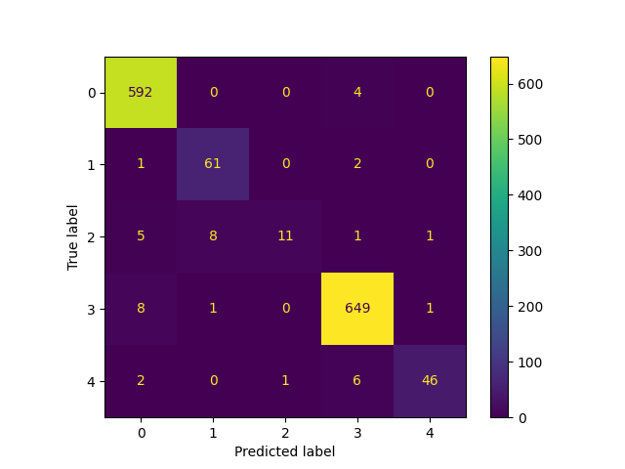

Bert
Valid loss | 0.4617
Valid acc | 0.8786
Macro precision | 0.94
Precision | 0.97

Slide 4
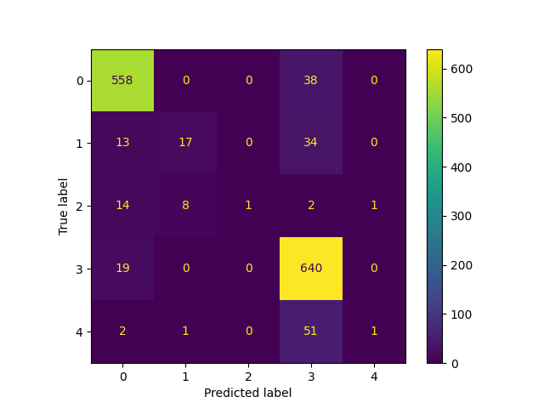
Albert
Valid loss | 0.8414
Valid acc | 0.7071
Macro precision | 0.78
Precision | 0.86

Slide 5

DistilBert
Valid loss | 0.7839
Valid acc | 0.7429
Macro precision | 0.90
Precision | 0.93

Slide 6
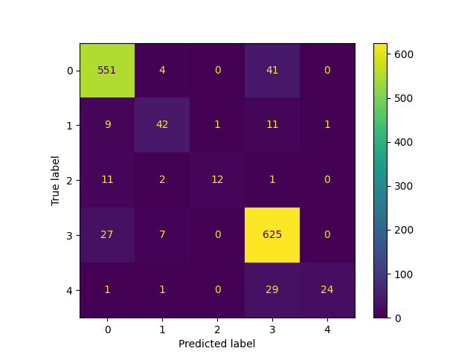
XLNet
Valid loss | 0.9431
Valid acc | 0.6571
Macro precision | 0.88
Precision | 0.89

Slide 7
Compare
 | Bert | Albert | DistilBert | XLNet
Valid loss | 0.4617 | 0.8414 | 0.7839 | 0.9431
Valid acc | 0.8786 | 0.7071 | 0.7429 | 0.6571
Macro precision | 0.94 | 0.78 | 0.90 | 0.88
Precision | 0.97 | 0.86 | 0.93 | 0.89

